Slide 1
Reduce polygons using Blender

Slide 2
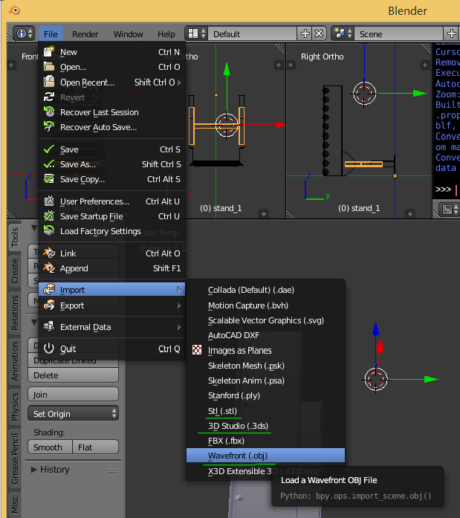
Import
File > Import > (.obj) or (.3ds) or (.stl)…
[Shift+C] to view the whole of object.
  And center 3d cursor at world origin
[a] to select/deselect all.
  Select[Ctrl+L] to select connected mesh.(edit mode)
[tab] to toggle Object/Edit modes.

Slide 3
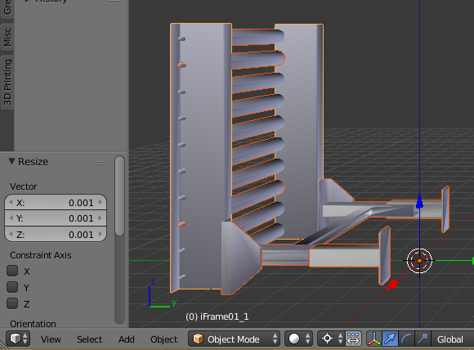
Unit and Geometry
Check the unit of the object.
  The units of object was millimeters.
Resize[s] the object to 1/1000.
  1mm = 0.001BU(1BlenderUnit = 1Meter)
Rotate[r] the object.(+[x,y,z] to lock axis)
  upward = Z axis.
Join[Ctrl+J] all objects and set a origin.

Slide 4
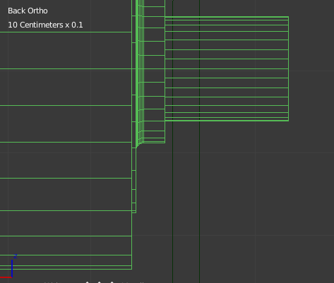
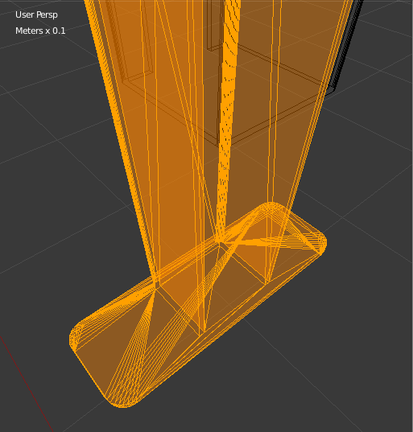
Reduce Triangles
Find part with excessive detail
  Apply the Modifier ‘Decimate’
  or
  Replace it with some simpler mesh.
  Cylinder uses many triangles.
  Bevels are too smooth.
  Hollows can be filled.

Slide 5
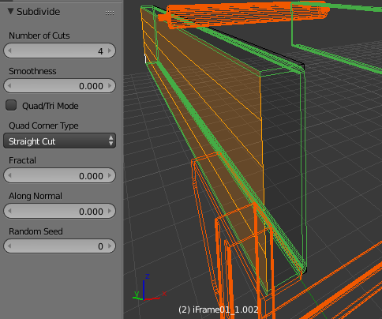
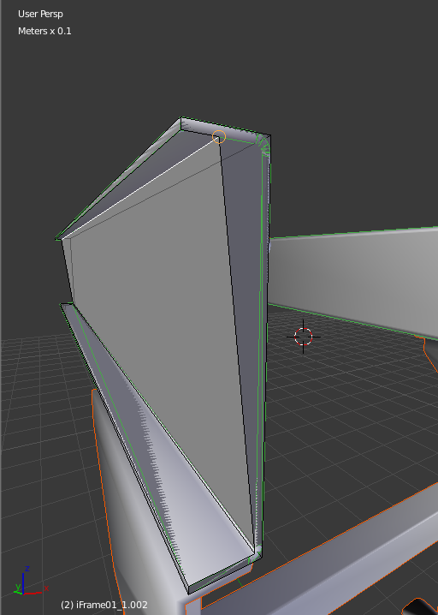
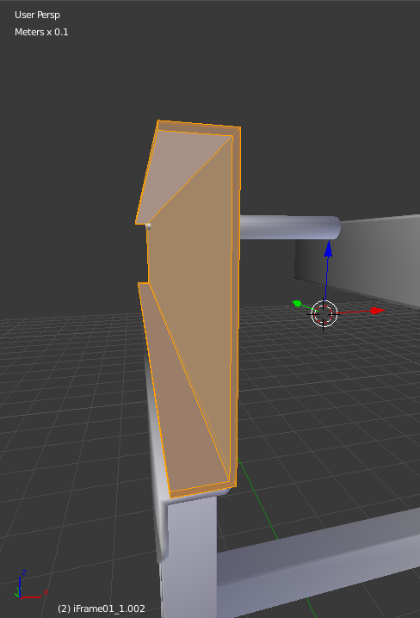
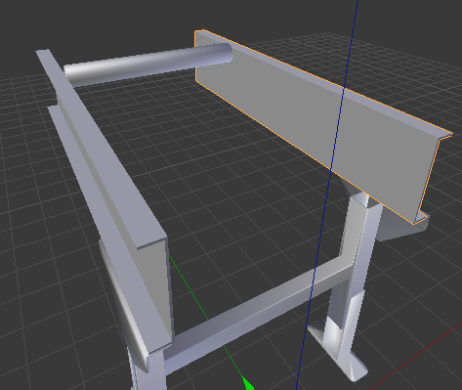
Base
Subdivide[w] surface and move edges.
Remove[x] the source object.
Duplicate[Shift-D] and Mirror[Ctrl-M] this for the other side.

Slide 6
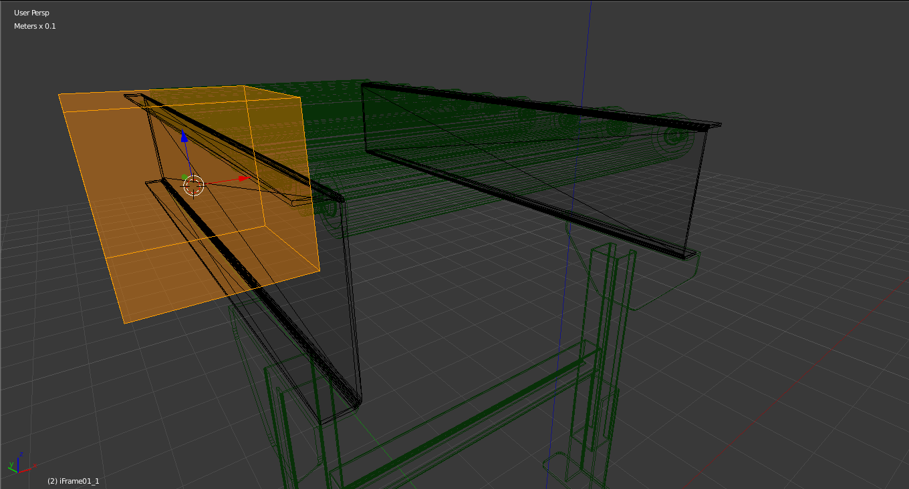
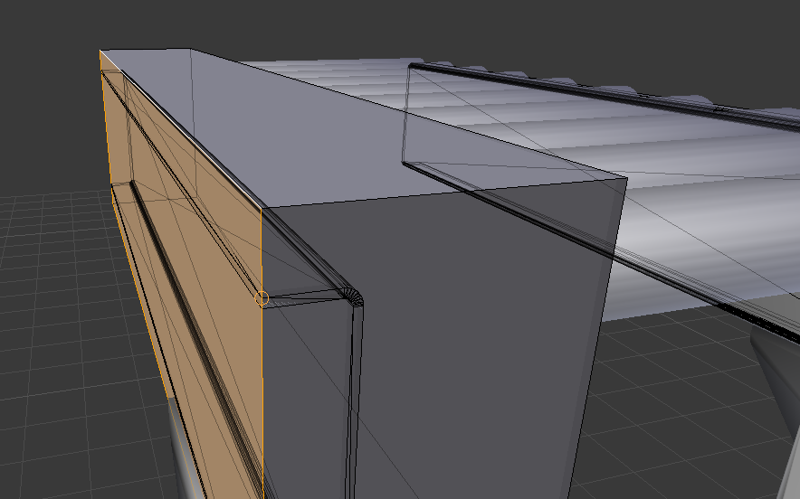
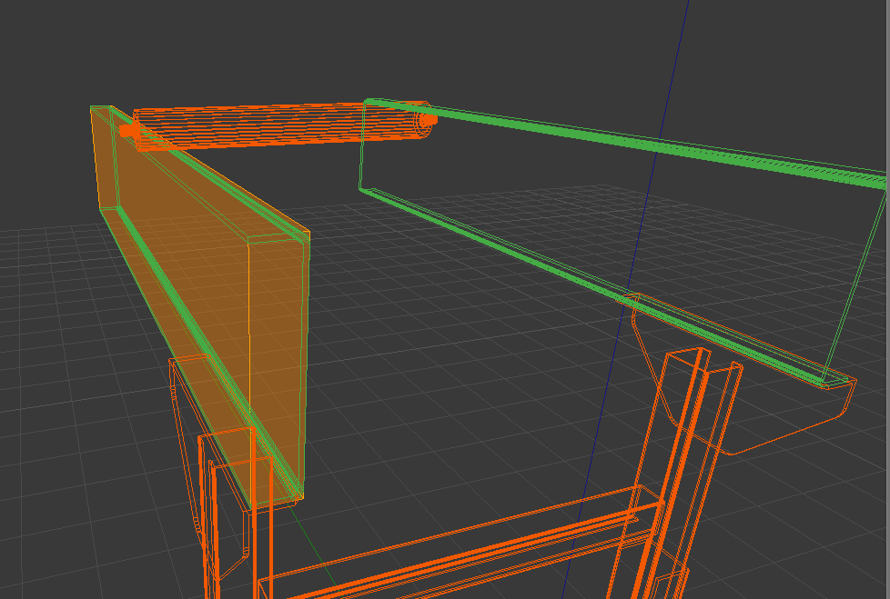
Base
Create[Shift-A] a new cube shape.
Move[g] surfaces of the cube.
Subdivide[w] surface and move[g] edges.
Remove[x] the source object.

Slide 7
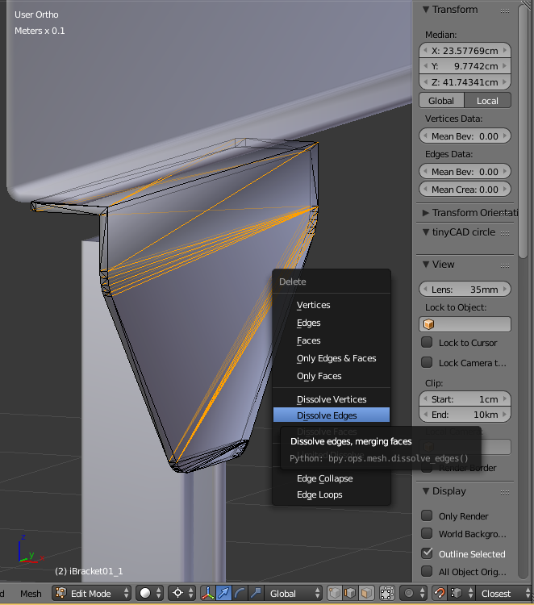
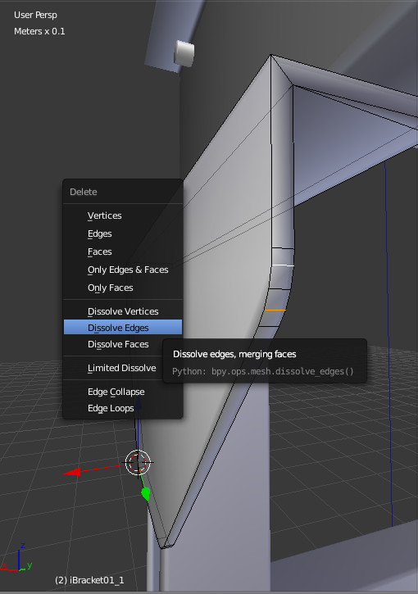
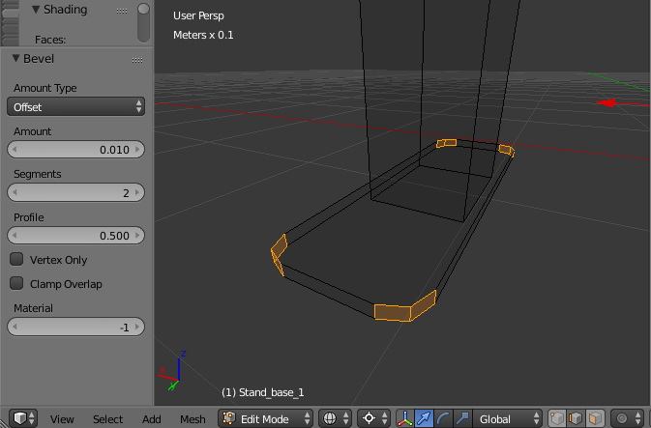
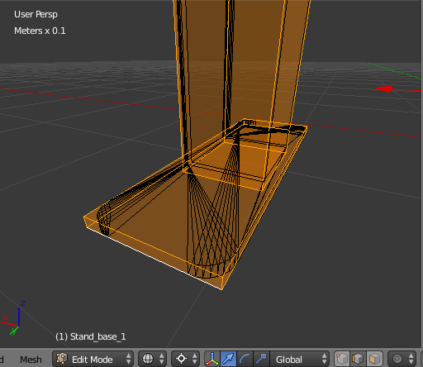
Feet
To reduce bevel edges, select mesh[Ctrl-L] then ‘Convert to Quad[Alt-J]’ and dissolve edges[x].
To add some bevels, select edge and press [Ctrl-B].

Slide 8
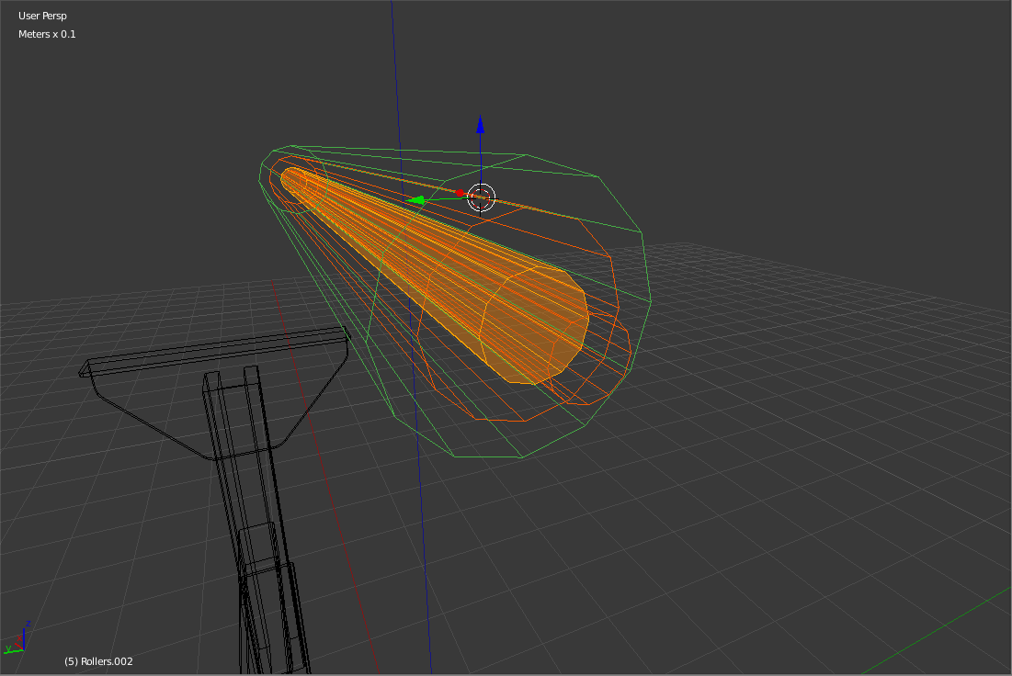
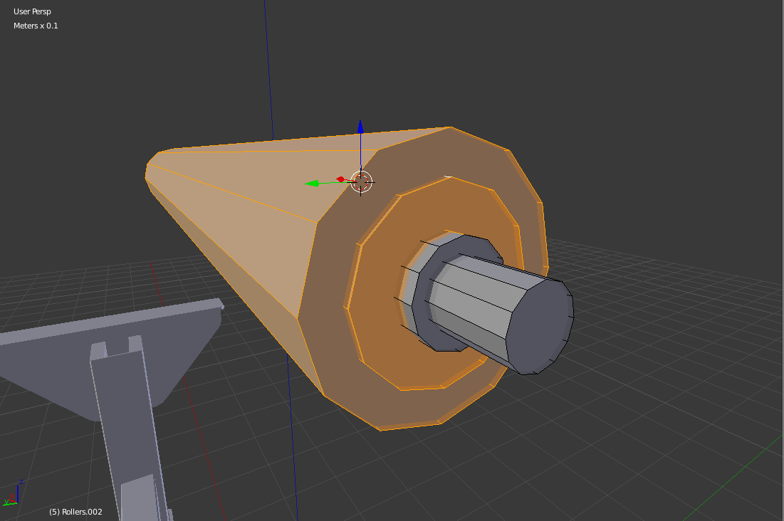
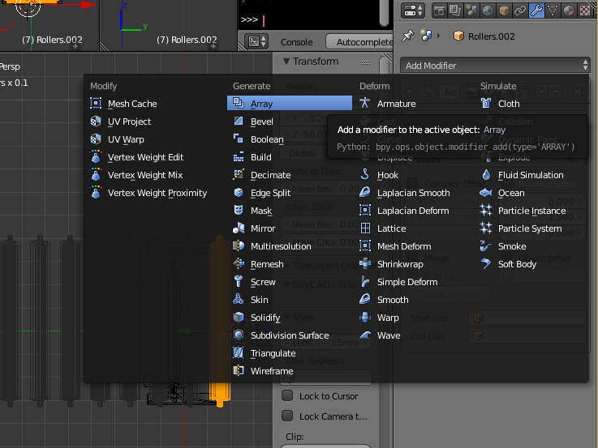
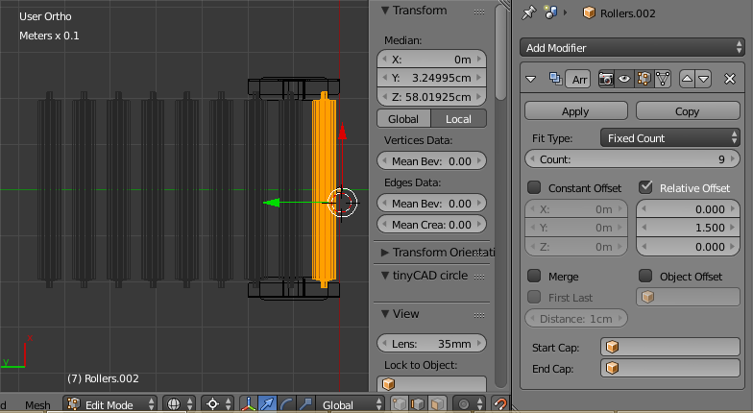
Rollers
Reduce the vertex of cylinder.
  Add cylinders and replace.
  (1916tris -> 176tris)x10
Use ‘Array modifier’.
  Count 10
  Set Relative Offset 1.5
1.5

Slide 9
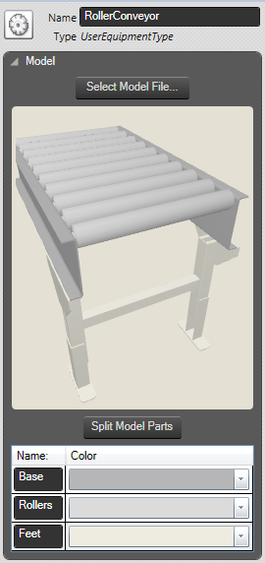
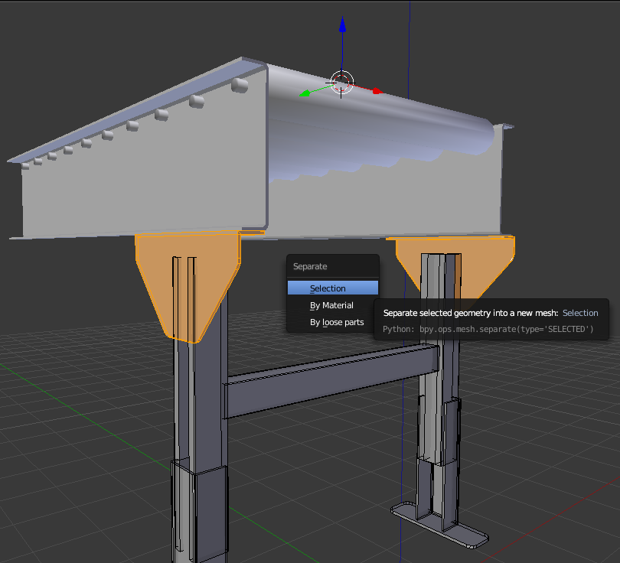
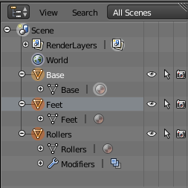
Model Parts
To make a group of meshes, select mesh and join[Ctrl-J].
To separate mesh, select mesh and press [p].
Use the same name for object and mesh.

Slide 10
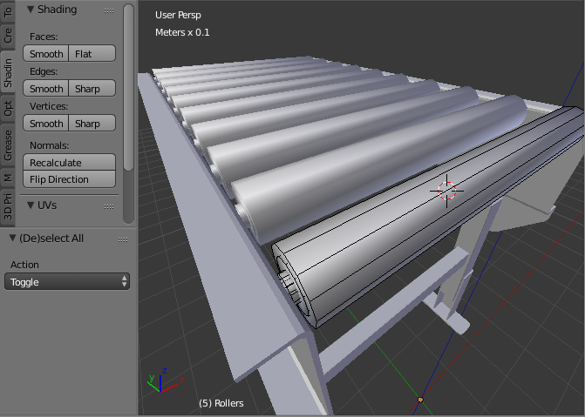
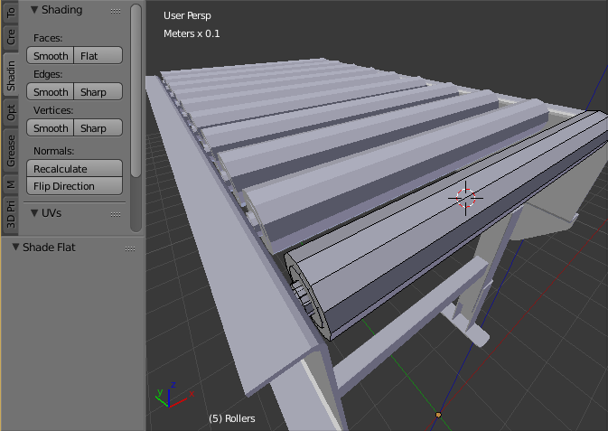
Shading
Change shade setting of mesh
  [w] ‘Shade flat’/’Shade smooth’.
If mesh has 2 or more different shade setting, these are counted as different model parts in Sym3.

Slide 11
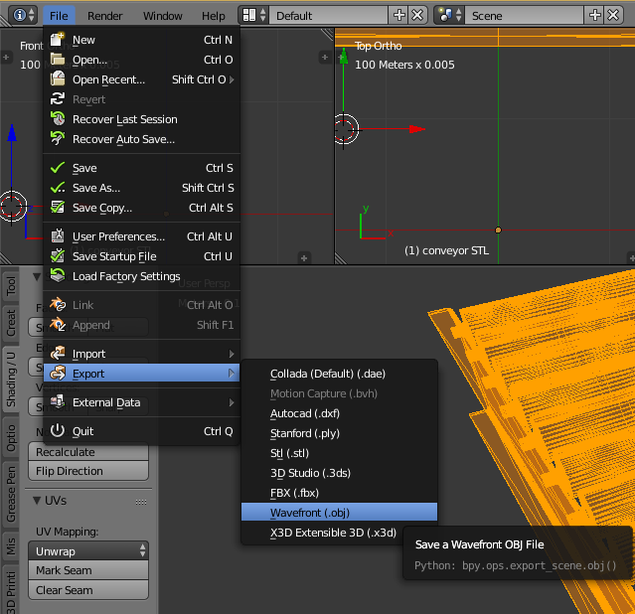
Export as OBJ
File size
  Original - 1680KB
  Reduced - 65KB
-1.6MB

